Slide 1
Publication traditions and literature search
Publication channels
Journals, conferences, workshops, etc.
Peer-reviewing
Bibliographic measures
Citations, H-index and I-index
Publication data bases
Google Scholar
DBPL computer science bibliography
Semantic Scholar
Bibliographic research indicator (BFI)
Danish system to measure research production and distribute money to the universities
AU Library in the Nygaard building
Publication traditions vary a lot from research area to research area
If there is a conflict between the general information in this talk and the more specific information given by your advisor, you should always believe your advisor

Slide 2
Publication channels
Scientific papers can be published in different ways
Journals are typically published 4-6 times a year (with 6-15 papers each time)
Conferences are scientific meetings typically taking place each year (with 20-100 papers each time) – there are also broad mega-conferences with hundreds of papers
Workshops are informal scientific meetings, which typically covers an emerging area and have less strict quality demands for accepted papers
Some conferences and workshops have tool sessions, where experimental computer tools are presented
Some conferences and workshops have poster sessions, where the author stands in front of a large poster and explains it to anyone interested
Within most sciences (naturvidenskab), journals are the only kind of publications which counts on your CV
In computer science things are different
Here it is often more prestigious to publish at the best conferences than it is to publish in the best journals
Many journals publish improved versions of the best papers from selected conferences (otherwise you cannot publish a paper twice)
The maximal number of pages are typically larger for a journal paper than for a conference paper (hence it is possible to add more examples, all details of proofs, etc.)

Slide 3
Peer reviewing
All (serious) journals and conferences are peer-reviewed (peer ≈ ligemand)
This means that all submissions are read and evaluated by 3-5 referees (reviewers) who are experts within the area covered by the submitted paper
The referees usually make a significant number of proposals for improvements and corrections of errors (including grammatical errors)
Based on the referee reports it is decided which papers should be accepted/rejected
The best conferences and journals have acceptance rates which typically are 10-20%
Hence, it is quite difficult to get papers accepted in these
It is prestigious to act as referee for a good conference/journal
It is something you list on your CV
It also takes a lot of your time

Slide 4
Organization of conferences
Each conference has a program committee with 20-30 PC-members headed by 1-2 two PC-chairs
All PC-members are well-known researchers within the area covered by the conference (typically appointed by a steering committee in cooperation with the PC-chairs)
The PC-chairs distribute the submitted papers to the PC-members, selecting those they believe to be the most knowledgeable within the area of the paper
PC-members may use sub-referees to help them evaluate a paper (this is often PostDocs or PhD students within the area)
Based on the written referee reports PC-chairs propose whether the individual papers should be accepted, discussed or rejected
Earlier, it was typical to have a physical program committee meeting
Today, all conferences use electronic systems (special webboards) and virtual program meetings – where people discuss and vote over a pre-determined period
The accepted papers are collected in conference proceedings (books) that are available at the conference
Authors are expected to improve their papers based on the comments in the referee report, but in practice there is seldom time to check this before the conference
But if you don't fix serious errors, you will be in "bad standing" next time you submit a paper
It will often be sent to the same referees, since they are the experts within your area

Slide 5
Organization of journals
Each journal has an editorial board with 6-12 members headed by an editor-in-chief (sometimes assisted by a number of associate editors)
All members of the editorial board are well-known researchers within the area covered by the journal (typically appointed by he editor-in-chief)
When a paper is submitted, the editor-in-chief appoints a person to handle the submission (typically an associate editor or another member of the editorial board)
The "handler" selects 2-3 reviewers (referees), who are experts within the area of the paper
The reviewers may use sub-referees to help them evaluate a paper (this is often PostDocs or PhD students within the area)
Based on the written referee reports, the "handler" proposes whether the paper should be accepted, rejected or can be resubmitted with minor/major improvements
The final decision is made by the editor-in-chief
The final revised papers are thoroughly checked by the original reviewers
Usually, authors provide a document in which they describe how the different proposals for improvements have been taken care of
For proposals that have not been followed, detailed arguments are given
For some journals, the final version of papers are checked by a professional with linguistic background

Slide 6
Comparison of conferences and journals
Each conference has a limited number of time slots available
When all slots are filled, additional papers must be rejected although some of them may be of high-quality
Such papers can be re-submitted next year or submitted to another conference
It is wise to improve the papers before resubmission – since it is likely that they will have one or more referees who have seen the old version
The turn-around time is short (typically 4-6 months from submission to conference)
There is an oral presentation at the conference (typically 15-20 minutes, followed by a short discussion)
Journals have "unlimited" space
Accepted papers are queued and will be published when there is space in the journal
If a paper is found good enough, it will be accepted
The turn-around time is long (typically 1-2 years from submission to publication)
Submissions can be done at any time
There is no oral presentation of the paper
Some journals have "special sections" covering a narrow area, e.g. with the best papers from a conference
Authors are invited to publish, and papers will usually be accepted if they are of decent quality
The space is limited (to some extend), and the turn-around time medium

Slide 7
Workshops and tool / poster sessions
Workshops are similar to conferences but with less strict reviewing
Papers with interesting ideas may be accepted even though they appear to have some flaws/gaps
Some workshop are totally open without peer-reviewing
Tool and poster sessions
Rules and quality vary a lot from event to event
It is a good way to show ongoing work and have discussions with colleagues, but they are seldom useful for your CV
There are exceptions. As an example, it is very prestigious to be allowed to present new interaction ideas at some of the best HCI-conferences
There is a significant number of bogus journals and conferences
All (or most papers) are accepted with no peer-reviewing or with referees who are unknown (internationally) in their field
Conferences are typically held at "touristic" places like Hawaii or a cruise ship
It will harm your CV to publish or referee at such places (since it indicates bad judgement from your side)

Slide 8
Bibliographic measures
Other sciences operate with "impact factors" which “measure” the quality of journals (based on the number of citations)
Since the majority of computer science publications are in conferences, impact factors have little importance/value within our field
Instead, it is common to look at the following quantitative measures for a researcher
Number of citations
The number of (peer-reviewed) papers that have a citation (reference) to a paper written by the researcher
h-index
The number of well-cited papers for the researcher
To have an H-index of N you must have N papers which each have at least N citations
i10-index
The number of papers which have at least 10 citations each
Good measure for the number of "serious" publications made by the researcher

Slide 9
Be careful when you compare two researchers
The (scientific) age has a big influence
Obviously, young researcher have much smaller numbers than old researchers
When a paper has been written, it takes months before it is published, and then several years before it is read and cited by other researchers
The M-index tries to handle this by dividing the H-index with the number of years since the first publication
The research area has a big influence
In mathematics, it is common to publish at most one paper per year
This obvious means that a researcher has few papers, and moreover there are few other papers that can make citations to them
Even within computer science, there are big differences from research area to research area
In some research areas, it is common that a young active researcher (e.g. a PhD student or a PostDoc) publish 10-20 papers a year
In other areas this number is much lower
Hence, it only makes sense to compare citations, H-index and I-index for researchers who are
within the same (or similar) research area
have the same (or nearly the same) scientific age

Slide 10
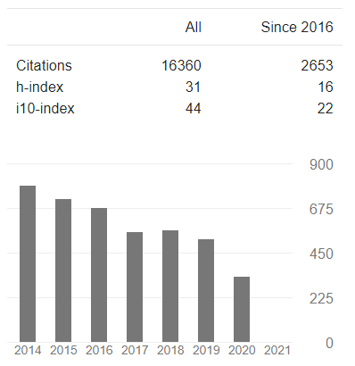
Google Scholar
One of the most commonly used data bases to investigate citations etc. within computer sicence
Includes conference papers – which are excluded by most other data bases
Each researcher maintains a profile, which makes the counts more reliable, since missing papers can be added, and wrong papers (e.g. by authors with the same name) can be removed
Google scholar overview
The last column counts citations made within the last 5 years
The papers that are cited may be much older
My publication profile is atypical
I have published relatively few papers
But my papers (and text books) have very high citation numbers
I have only published 3 papers over the last 10 years (since I have been heavily involved in the leadership of the department)
Kurt Jensen

Slide 11
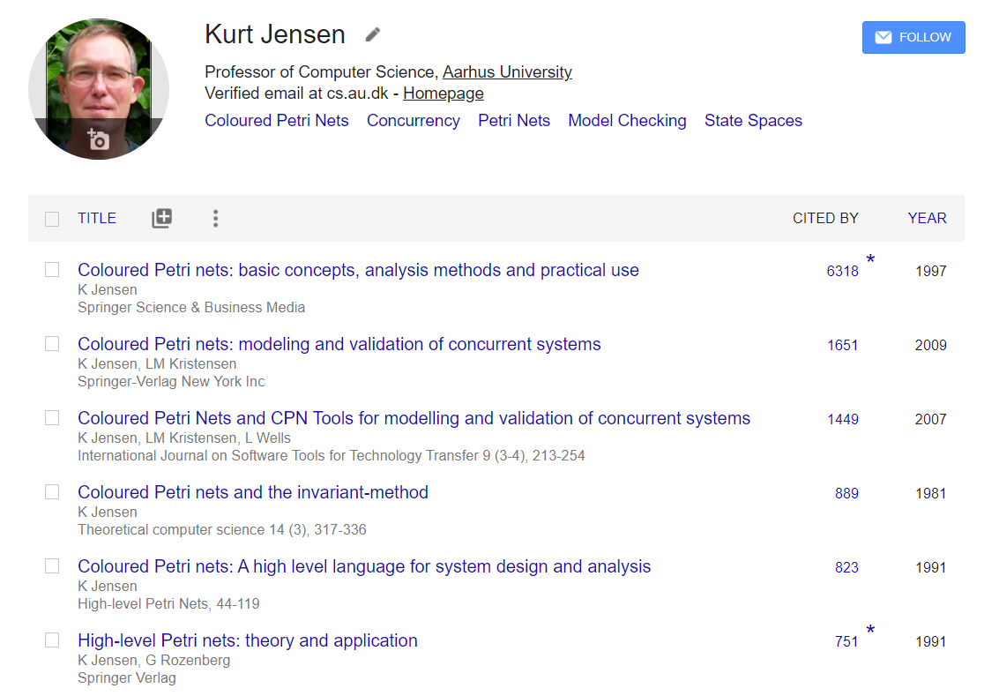
Google Scholar (papers ordered by citations)

Slide 12
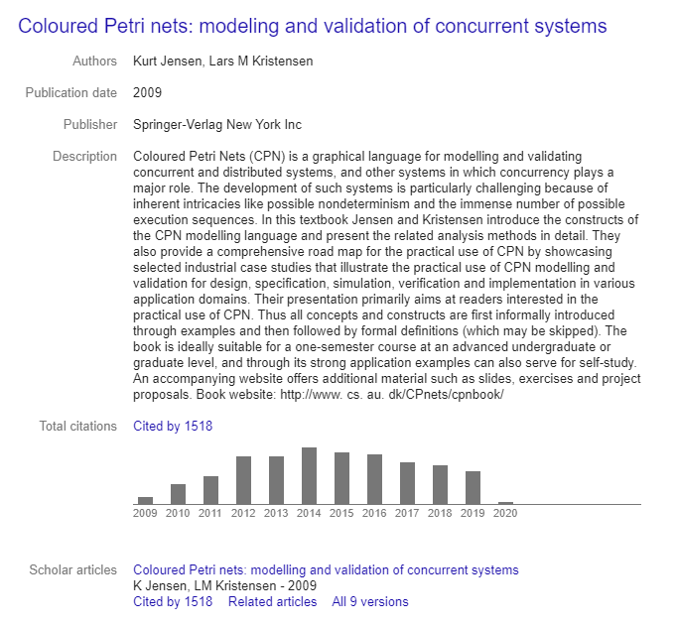
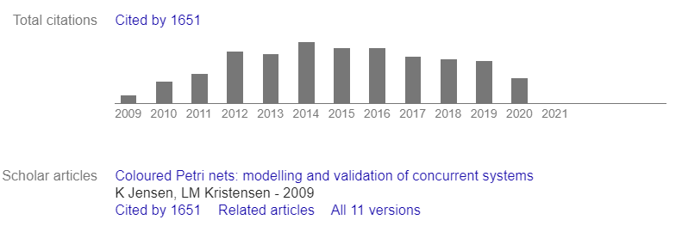
Individual papers
You can click on the individual papers to
See where it is published, citation statistics, the beginning of the abstract, etc.
download the paper (in most cases)
To download, you often need to access the data bases of different publishing companies such as Springer, Elsevier, ACM, etc.
AU has licenses to many of these
To use them, you must be on the AU network (e.g. via vpn)
For help, ask your advisor or our library staff
Many CS researchers have copies of their papers on their personal home pages (which Google Scholar has a reference to)
PDF

Slide 13
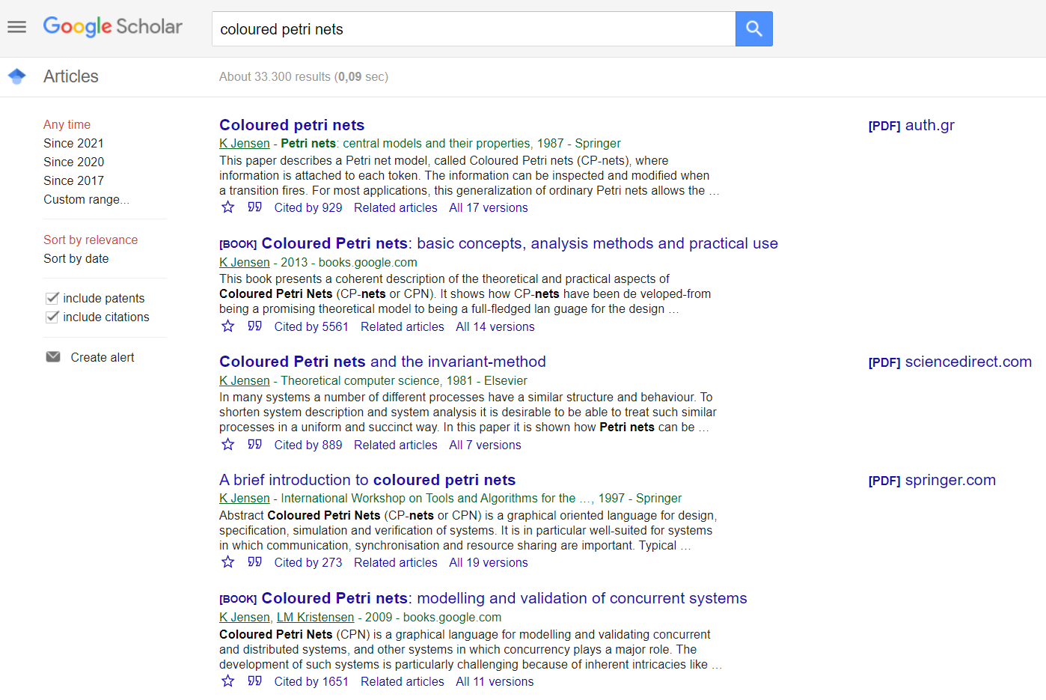
Search for papers without specifying the author
Search for “colored Petri nets" (US spelling) gives another 39.400 hits
About 33.300 results (0,09 sec)
Different search criteria by which you can limit the search
In some research areas, it may also be important to search for patents

Slide 14
DBLP computer science bibliography
Contains more than 5 million journal articles, conference papers, and other publications in computer science
Covers all important journals and many conferences
Maintained by the University of Trier, Germany since 1993
A lot of different information is available (you can search for persons, conferences, journals, publication series, etc.)
More information
Data base Link
Wikepedia Link
Scientific paper on the history and development of DBLP Link (demands that you have access to Springer LINK)

Slide 15
Semantic Scholar
Contains nearly 200 million papers from computer science and biomedicine
Covers all important journals and many conferences
Maintained by the Allen Institute for Artificial Intelligence since 2015
Adds a layer of semantic analysis to the traditional methods of citation analysis
A lot of different information is available
More information
Data base Link
Wikepedia Link
Scientific paper on the history and development of Semantic Scholar Link

Slide 16
Bibliographic Research Indicator (BFI)
List of journals and conferences (not individual papers)
The Bibliometric Research Indicator (BFI) provides an overview of research publications from Danish universities
Within each research area (such as computer science), all peer-reviewed publications are divided into two groups (by an appointed group of scientists)
A publication in the best group gives 3 points, while a publication in the other group only gives 1 point
Total number of points are used to distribute money between the Danish universities
Conferences also count within computer science (but not in other areas)
Use
BFI can be used to compare universities, faculties and departments – but only within Denmark
It cannot be used to find individual publications or individual persons
Links
Data base and information Link

Slide 17

AU Library, Katrinebjerg
Librarian Rasmus T. Nielsen, rtni@kb.dk, Nygaard-170b
www.library.au.dk Link
Seeking information
http://library.au.dk/en/students/information-seeking/ Link
Subject guides
http://library.au.dk/en/subject-areas/electrical-and-computer-engineering/ Link

Slide 18
That's all for now… … questions

